Slide 1
Introduction to Networking
CT043-3-1 & Version VE1
Data Link Layer

Slide 2
Data Link Layer
Notes:
Cisco Networking Academy Program
Introduction to Networks v7.0 (ITN)
Module 6: Data Link Layer

Slide 3
.
Topics and Structure of the lesson
Topic Title | Topic Objective
Purpose of the Data Link Layer | Describe the purpose and function of the data link layer in preparing communication for transmission on specific media.
Topologies | Compare the characteristics of media access control methods on WAN and LAN topologies.
Data Link Frame | Describe the characteristics and functions of the data link frame.
Notes:
3
6.0 - Data Link Layer - Introduction
6.0.2 – What will I learn to do in this module?

Slide 4
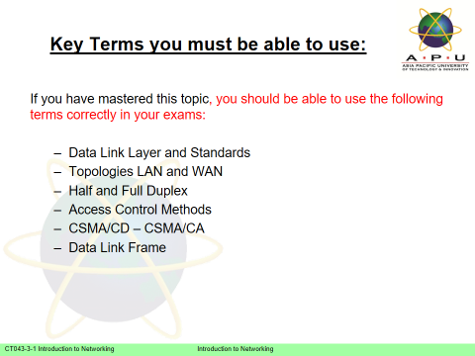
Contents & Structure

Slide 5
Purpose of the Data Link Layer
Notes:
6 - Data Link Layer
6.1 - Purpose of the Data Link Layer

Slide 6
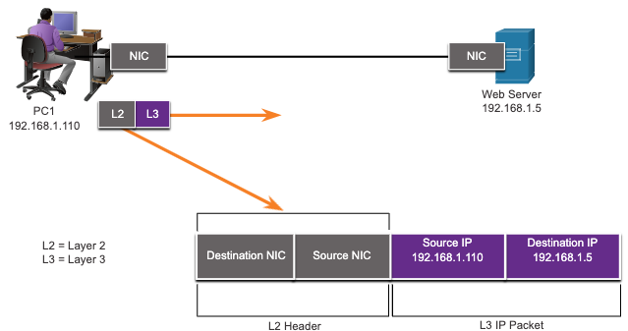
Purpose of the Data Link Layer The Data Link Layer
The Data Link layer is responsible for communications between end-device network interface cards.
It allows upper layer protocols to access the physical layer media and encapsulates Layer 3 packets (IPv4 and IPv6) into Layer 2 Frames.
It also performs error detection and rejects corrupts frames.
Notes:
6 – Data Link Layer
6.1 – Purpose of the Data Link Layer
6.1.1 – The Data Link Layer

Slide 7
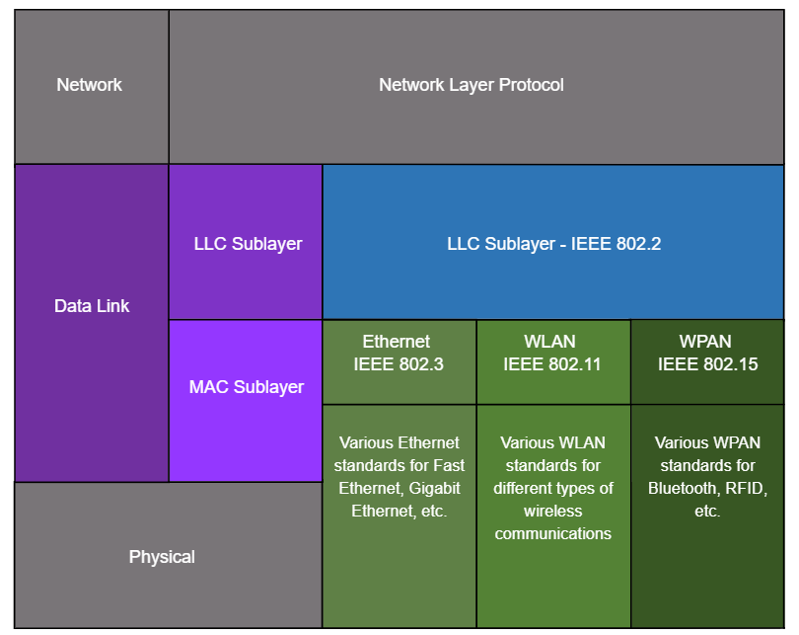
Purpose of the Data Link Layer IEEE 802 LAN/MAN Data Link Sublayers
IEEE 802 LAN/MAN standards are specific to the type of network (Ethernet, WLAN, WPAN, etc).
The Data Link Layer consists of two sublayers. Logical Link Control (LLC) and Media Access Control (MAC).
The LLC sublayer communicates between the networking software at the upper layers and the device hardware at the lower layers.
The MAC sublayer is responsible for data encapsulation and media access control.
Notes:
6 – Data Link Layer
6.1 – Purpose of the Data Link Layer
6.1.2 – IEEE 802 LAN/MAN Data Link Sublayers

Slide 8
Purpose of the Data Link Layer Providing Access to Media
Packets exchanged between nodes may experience numerous data link layers and media transitions.
At each hop along the path, a router performs four basic Layer 2 functions:
Accepts a frame from the network medium.
De-encapsulates the frame to expose the encapsulated packet.
Re-encapsulates the packet into a new frame.
Forwards the new frame on the medium of the next network segment.
Notes:
6 – Data Link Layer
6.1 – Purpose of the Data Link Layer
6.1.3 – Providing Access to Media

Slide 9

Purpose of the Data Link Layer Data Link Layer Standards
Data link layer protocols are defined by engineering organizations:
Institute for Electrical and Electronic Engineers (IEEE).
International Telecommunications Union (ITU).
International Organizations for Standardization (ISO).
American National Standards Institute (ANSI).
Notes:
6 – Data Link Layer
6.1 – Purpose of the Data Link Layer
6.1.4 – Data Link Layer Standards
6.1.5 – Check Your Understanding – Purpose of Data Link Layer

Slide 10
Topologies
Notes:
6 - Data Link Layer
6.2 - Topologies

Slide 11
Topologies Physical and Logical Topologies
The topology of a network is the arrangement and relationship of the network devices and the interconnections between them.
There are two types of topologies used when describing networks:
Physical topology – shows physical connections and how devices are interconnected.
Logical topology – identifies the virtual connections between devices using device interfaces and IP addressing schemes.
Notes:
6 – Data Link Layer
6.2 – Topologies
6.2.1 – Physical and Logical Topologies

Slide 12
Topologies WAN Topologies
There are three common physical WAN topologies:
Point-to-point – the simplest and most common WAN topology. Consists of a permanent link between two endpoints.
Hub and spoke – similar to a star topology where a central site interconnects branch sites through point-to-point links.
Mesh – provides high availability but requires every end system to be connected to every other end system.
Notes:
6 – Data Link Layer
6.2 – Topologies
6.2.2 – WAN Topologies

Slide 13
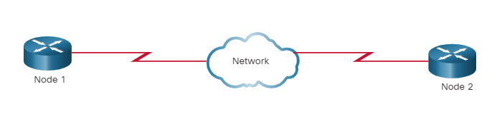
Topologies Point-to-Point WAN Topology
Physical point-to-point topologies directly connect two nodes.
The nodes may not share the media with other hosts.
Because all frames on the media can only travel to or from the two nodes, Point-to-Point WAN protocols can be very simple.
Notes:
6 – Data Link Layer
6.2 – Topologies
6.2.3– Point-to-Point WAN Topology

Slide 14
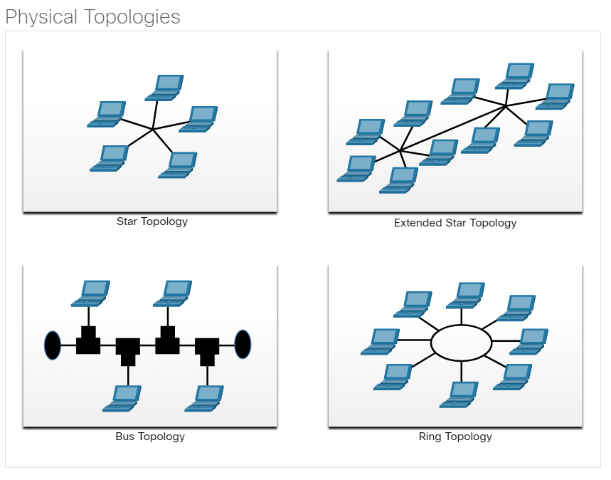
Topologies LAN Topologies
End devices on LANs are typically interconnected using a star or extended star topology. Star and extended star topologies are easy to install, very scalable and easy to troubleshoot.
Early Ethernet and Legacy Token Ring technologies provide two additional topologies:
Bus – All end systems chained together and terminated on each end.
Ring – Each end system is connected to its respective neighbors to form a ring.
Notes:
6 – Data Link Layer
6.2 – Topologies
6.2.4 – LAN Topologies

Slide 15
Topologies Half and Full Duplex Communication
Half-duplex communication
Only allows one device to send or receive at a time on a shared medium.
Used on WLANs and legacy bus topologies with Ethernet hubs.
Full-duplex communication
Allows both devices to simultaneously transmit and receive on a shared medium.
Ethernet switches operate in full-duplex mode.
Notes:
6 – Data Link Layer
6.2 – Topologies
6.2.5 – Half and Full Duplex Communication

Slide 16
Topologies Access Control Methods
Contention-based access
All nodes operating in half-duplex, competing for use of the medium. Examples are:
Carrier sense multiple access with collision detection (CSMA/CD) as used on legacy bus-topology Ethernet.
Carrier sense multiple access with collision avoidance (CSMA/CA) as used on Wireless LANs.
Controlled access
Deterministic access where each node has its own time on the medium.
Used on legacy networks such as Token Ring and ARCNET.
Notes:
6 – Data Link Layer
6.2 – Topologies
6.2.6 – Access Control Methods

Slide 17
Topologies Contention-Based Access – CSMA/CD
CSMA/CD
Used by legacy Ethernet LANs.
Operates in half-duplex mode where only one device sends or receives at a time.
Uses a collision detection process to govern when a device can send and what happens if multiple devices send at the same time.
CSMA/CD collision detection process:
Devices transmitting simultaneously will result in a signal collision on the shared media.
Devices detect the collision.
Devices wait a random period of time and retransmit data.
Notes:
6 – Data Link Layer
6.2 – Topologies
6.2.7 – Contention-Based Access – CSMA/CD

Slide 18
Topologies Contention-Based Access – CSMA/CA
CSMA/CA
Used by IEEE 802.11 WLANs.
Operates in half-duplex mode where only one device sends or receives at a time.
Uses a collision avoidance process to govern when a device can send and what happens if multiple devices send at the same time.
CSMA/CA collision avoidance process:
When transmitting, devices also include the time duration needed for the transmission.
Other devices on the shared medium receive the time duration information and know how long the medium will be unavailable.
Notes:
6 – Data Link Layer
6.2 – Topologies
6.2.8 – Contention-Based Access – CSMA/CA
6.2.9 – Check Your Understanding - Topologies

Slide 19
Data Link Frame
Notes:
6 - Data Link Layer
6.3 - Data Link Frame

Slide 20
Data Link Frame The Frame
Data is encapsulated by the data link layer with a header and a trailer to form a frame.
A data link frame has three parts:
Header
Data
Trailer
The fields of the header and trailer vary according to data link layer protocol.
The amount of control information carried with in the frame varies according to access control information and logical topology.
Notes:
6 – Data Link Layer
6.3 – Data Link Frame
6.3.1 – The Frame

Slide 21
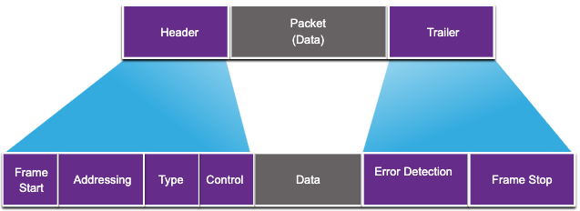
Data Link Frame Frame Fields
Field | Description
Frame Start and Stop | Identifies beginning and end of frame
Addressing | Indicates source and destination nodes
Type | Identifies encapsulated Layer 3 protocol
Control | Identifies flow control services
Data | Contains the frame payload
Error Detection | Used for determine transmission errors
Notes:
6 – Data Link Layer
6.3 – Data Link Frame
6.3.2 – Frame Fields

Slide 22
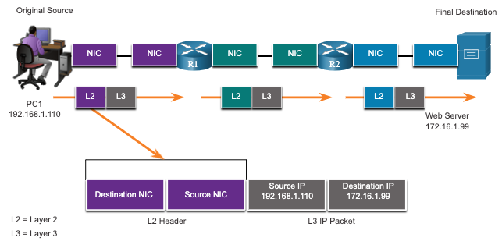
Data Link Frame Layer 2 Addresses
Also referred to as a physical address.
Contained in the frame header.
Used only for local delivery of a frame on the link.
Updated by each device that forwards the frame.
Notes:
6 – Data Link Layer
6.3 – Data Link Frame
6.3.3 – Layer 2 Address

Slide 23
Data Link Frame LAN and WAN Frames
The logical topology and physical media determine the data link protocol used:
Ethernet
802.11 Wireless
Point-to-Point (PPP)
High-Level Data Link Control (HDLC)
Frame-Relay
Each protocol performs media access control for specified logical topologies.
Notes:
6 – Data Link Layer
6.3 – Data Link Frame
6.3.4 – LAN and WAN Frames
6.3.5 – Check Your Understanding – Data Link Frame

Slide 24
Summary
Notes:
4-Physical Layer
4.8 - Summary

Slide 25
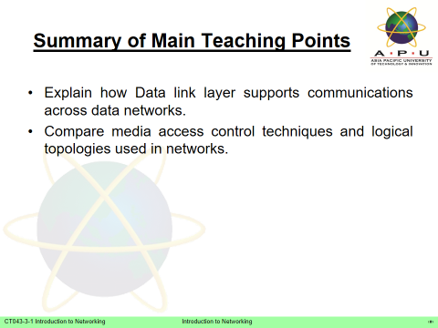
Summary / Recap of Main Points

Slide 26
Q & A

Slide 27
What To Expect Next Week
In Class
Ethernet

